Slide 1
ICT Word Processing Lesson 2: Formatting, Editing, and Printing Documents

Slide 2
Objectives – Lesson 2
7.2.1: Define the term "format" as it relates to word processing.
7.2.2: Identify common keyboard shortcuts used in word processors, and explain the benefits of using shortcuts.
7.2.3: Format the page setup of a document, including margins, line spacing, indents, headers vs. footers, orientation.
7.2.4: Explain printing options in a word processor, gutters, and document orientation.
7.2.5: Copy, paste and move text within a document using mouse, menu and keyboard techniques.
7.2.6: Copy, paste and move text among multiple documents using mouse, menu and keyboard techniques.
7.2.7: Modify document view settings to display close-up, single and multiple pages.
7.2.8: Format text using styles and font tools in a word processor.
7.2.9: Format a document using multi-level heading styles to enable an outline view (e.g., document map, navigation pane) in a word processor.
7.2.10: Create a table of contents using auto-generation tools and techniques in a word processor.
7.2.11: Insert page breaks in a document.
7.2.12: Create source citations and/or a bibliography in a document.
7.2.13: Insert a current date and time stamp into a document.
7.2.14: Use word processor tools to determine the number of pages, words and characters in a document.

Slide 3
Setting Up Your Pages
When you create a new document you can “format” it – meaning change how a document appears with:
Page orientation
Landscape – best use for wider writing space
Portrait – default setting
Paper Sizes
Letter – 8.5 inches wide by 11 inches long is the most common

Slide 4
Setting Up Your Pages
You can also adjust the margins “white space around all sides of the page” to define the layout of your document.
By default the margins are set to 1” in most word processing applications
The top margin is called header – includes information like the document title
The bottom margin is called the footer - includes information about the document such as page numbers, file names, dates

Slide 5
Let’s Watch the Video
How to change the layout in a Google Doc and Word Document
Click Here
Notes:
Discuss types of connections – “Connecting to the Internet” video

Slide 6
Setting Up Your Pages
Insert menu also contains a command to quickly insert
Page Numbers in your document, either in the header or footer margin section.
Date & Time in whichever format you prefer, i.e. MM/DD/YYYY or DD-MM-YYYY
And more…

Slide 7
Let’s Watch the Video
How to add headers , footers, and page numbers
Click Here
Notes:
Discuss types of connections – “Connecting to the Internet” video

Slide 8
Formatting Text - Alignment
Paragraph Alignment can be changed using the icons to adjust the text in your document, left, center, right, or justified– evenly distributes text between your margins
Each paragraph you type displays the text in evenly spaced lines. This space is defined by the Line Spacing command.

Slide 9
Formatting Text – Tab
Tab key indents text by a half inch to the beginning of paragraphs
Indenting your paragraph is another way to create a visual break in your document to show emphasis or change in topic.
Tab stops aligns the text to the tab selection icon of the horizontal ruler:
Icon | Tab Stop | Description
 | Left Tab | Aligns the text to left at the designated stop.
 | Center Tab | Centers the text at the designated stop.
 | Right Tab | Aligns the text to the right at the designated stop.
 | Decimal Tab | Aligns numbers around a decimal point. Without regard to the number of digits, the decimal point remains in the same position.
 | Bar Tab | Inserts a vertical black line in the text at the designated stop.

Slide 10
Formatting Text – Horizontal Rule
You can also indent an entire paragraph using the Decrease Indent and Increase Indent commands on the Home toolbar/ribbon.
Another way to create a visual break in your document is to insert a horizontal line between paragraphs. The horizontal line will extend from the left margin to the right margin.

Slide 11
Let’s Watch the Video
How to add tab stops and horizontal rules
Click Here
Notes:
Discuss types of connections – “Connecting to the Internet” video

Slide 12
Formatting Text - Fonts
Fonts are used to change how the letters on the page “look”. The most common ones are:
Arial
Calibri
Times New Roman
To quickly place emphasis on a word, use the Bold, Italics and/or Underline commands
The color of the text can also be changed using Font Color command on the toolbar or ribbon

Slide 13
Formatting Text – Paint Format
You can quickly apply any format elements to other text in your document using the Format Painter commands
Another way to apply format elements is through the use of styles. A style contains multiple format elements: font, font size, line spacing, paragraph alignment and emphasis (bold, italics and/or underline).

Slide 14
Let’s Watch the Video
How to work with fonts and styles
Click Here
Notes:
Discuss types of connections – “Connecting to the Internet” video

Slide 15
Formatting Text – Copy, Paste, Clipboard
Cut command will remove the selected text from its current location
Paste command will insert the text into the new position.
Copy command takes a picture of the selected text and uses
Paste command to insert a “copy” of the text in other locations.
When you cut or copy text or an object, it is placed in a temporary storage space called a Clipboard. The Clipboard can hold text, images, files and many other items.
Google Docs has a Web Clipboard that temporarily stores items you have copied for one month.

Slide 16
Let’s Watch the Video
How to copy, cut, and paste
Click Here
Notes:
Discuss types of connections – “Connecting to the Internet” video

Slide 17
Formatting Text – Undo, Redo
Located in the quick access toolbar are:
Undo command, you can quickly back out the change and restore your document to its original format.
Shortcut: Ctrl + Z
Redo command to restore whatever was undone.
Shortcut: Ctrl + Y
Save command to quickly save any document
Shortcut: Ctrl + S

Slide 18
Let’s Watch the Video
How to undo & redo in Microsoft Word and Google Docs
Click Here
Notes:
Discuss types of connections – “Connecting to the Internet” video

Slide 19
Formatting Text – Hyperlinks
A word processor can detect a web address and will automatically format it – changing its color, adding an underline and making it an active hyperlink
www.google.com
Shortcut:
Highlight the text first
Ctrl + K
Enter the URL

Slide 20
Let’s Watch the Video
How to creating hyperlinks
Click Here
Notes:
Discuss types of connections – “Connecting to the Internet” video

Slide 21
Finding and Proofing Content
Spelling & Grammar is a checking tool to review not only misspelled words but the use of incorrect grammar.
You will only see this red marking while you are working in your document. If you right-click on the marked word, your word processor will show you possible correct spellings
Research command helps when you are trying to find the definition of a word in your document
While the finding and proofing options in your word processors help with many common spelling and typing errors in your document, manual proofreading is still necessary.

Slide 22
Finding and Proofing Content
Find and Replace commands can seek out and replace all the occurrences of a specific word throughout the entire document
You can search for text and not replace it too.
Google Docs has a Research tool that enables you to search for information without leaving your document. You can use the tool to conduct a web search for information, images, quotes, citations, videos and data that you can quickly insert into your document.
After selecting the word, you right-click and choose ‘Explore Researh’

Slide 23
Let’s Watch the Video
How to find and replace
Click Here
Notes:
Discuss types of connections – “Connecting to the Internet” video

Slide 24
Advance Formatting
A Table of Contents is inserted in the first few page of a long document to help inform the reader about what the document contains and provides page number references to direct the reader to a specific topic.
Common styles Heading 1 - Heading 6 are used to create an outline format to your document.
A Navigation Pane can help you view the document map while you create and modify your document – it gives you a guide for the table of contents
Page breaks can be inserted anywhere in your document to force text to the next page – this helps organize your document – Ctrl + Enter is the shortcut

Slide 25
Let’s Watch the Video
How to add a table of contents
Click Here
Notes:
Discuss types of connections – “Connecting to the Internet” video

Slide 26
Citing Sources
Citing Sources used to create your work, you give credit not only to the authors of the words, thoughts and ideas, but also recognize the publishing companies that made those works available.
MLA Format uses a bibliography or Works Cited page to detail the resource, including authors, publishers, date of publications or copyright, web address and pages used.
Footnotes are notes appearing at the bottom (or ‘foot’) of the page that provide the reader an indication and identification of the text in the document that is not your own.
Not giving credit is considered Plagiarism – stealing someone else’s words or ideas. This is considered an act of theft or fraud and it is punishable by law.

Slide 27
Other Tools for Working with Documents
Word Count Command allows you to see:
Pages: Total number of pages in your document.
Words: Total count of words in your document.
Characters (no spaces): Total number of characters (letters, numbers, punctuation and special characters) in your document.
Characters (with spaces): Total number of characters - including spaces - in your document.
Paragraphs: Total number of paragraphs in your document.
Lines: Total number of lines in your document.

Slide 28
Options for Viewing
Located on the lower right-corner of the word document you can find:
Print Layout: Displays your document pages with the top and bottom margins included on the screen.
Full Screen Reading Mode: Hides the ribbon and menus, presenting only the pages of the document in two-page reading layout. Esc key restores your menu bar and toolbar.
Web Layout: View your document as it would appear on a webpage.
Outline: Uses the Heading styles, Body, and Normal styles to display your document in an outline format.
Draft: Displays only the text in your document, hiding headers/footers and certain objects from view so you can focus on just text.
Zoom: Increases the magnification of your document to fill the width of your screen.

Slide 29
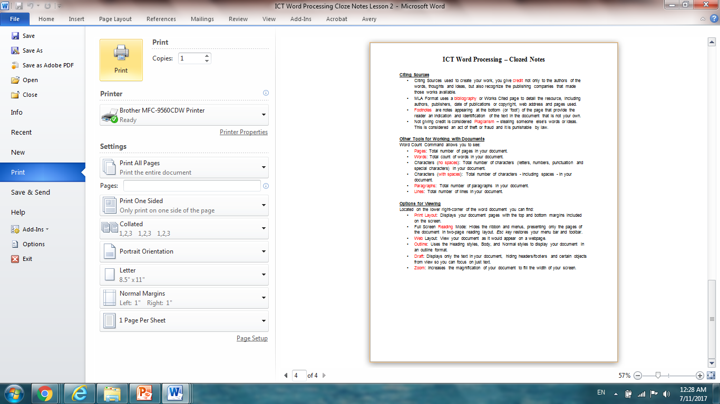
Options for Printing
Before printing, you can see how your word processor will print your document using the Print Preview mode – with other options.

